Slide 1
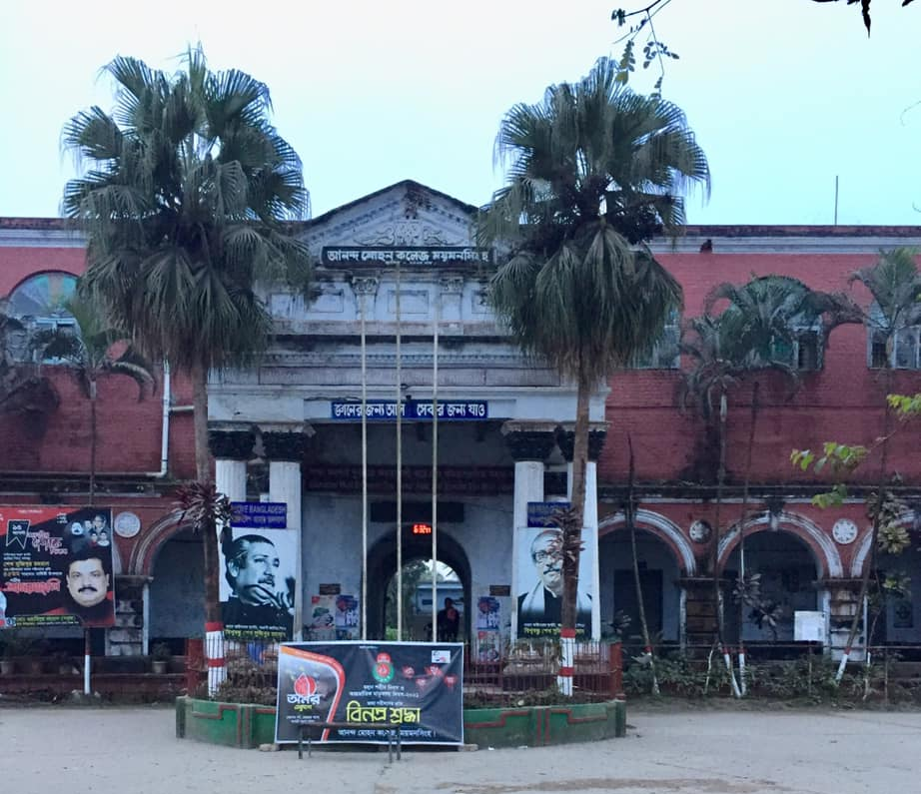
Welcome to
Class for
BBA 4th year students
of
Accounting Department

Slide 2
Course title: Research Methodology Chapter 2 : Secondary Data
Research in Digital Age
Presented by
Mushfique Ahmed
Professor, Dept. of Accounting
Ananda Mohan College, Mymensingh
Email: musfique64@gmail.com

Slide 3
Questions
What is Secondary data?
What are the advantages of using secondary data in research?
Distinguish between primary and secondary data.
What are the sources of secondary data?
What factors should be considered while using secondary data in research?

Slide 4
Secondary data
Secondary data are the data that have been collected in the past by someone else but made available for others to use. They are usually once primary data but become secondary when used by a third party.
Secondary data are usually easily accessible to researchers and individuals because they are mostly shared publicly.

Slide 5
Advantages of Secondary data
It is economical. It saves efforts and expenses.
It is time saving.
It helps to improve the understanding of the problem.
It provides a basis for comparison for the data that is collected by the researcher.

Slide 6
What are the sources of secondary data
Books: Books are one of the most traditional ways of collecting data.
Published Sources: Published sources may be printed or electronic as the case may be.
Journal: Journals are gradually becoming more important than books these days when data collection is concerned.
Newspapers: In most cases, the information passed through a newspaper is usually very reliable. Hence, making it one of the most authentic sources of collecting secondary data.
Websites: The information shared on websites are mostly not regulated and as such may not be trusted compared to other sources. However, there are some regulated websites that only share authentic data and can be trusted by researchers.
Blogs: Blogs are one of the most common online sources for data and may even be less authentic than websites. A blog is a discussion or informational website published on the World Wide Web consisting of discrete, often informal diary-style text entries (posts).
Government Records: Some of these records include; census data, health records, education institute records, etc.
Podcasts : Podcasts are gradually becoming very common these days, and a lot of people listen to them as an alternative to radio. podcast is an episodic series of spoken word digital audio files that a user can download to a personal device for easy listening.

Slide 7
Primary data
Secondary Data
Primary data is the type of data that is collected by researchers directly from main sources.
secondary data is the data that has already been collected through primary sources and made readily available for researchers to use for their own research.
The type of data provided by primary data is real-time.
While the data provided by secondary data is stale (old)
Researchers have to spend long time for collecting, recording, and analyzing the primary data.
Secondary data are quick and easy to collect and data can be collected and analyzed within a short time.
Primary data are usually raw and will have to be simplified by the researcher.
Secondary data is usually made available to the public in a simple form for a layman to understand.
Primary data can be collected using surveys and questionnaires, interview, observation etc.
while secondary data are collected using the library, internet, government records etc.
Primary data are more accurate and reliable while
secondary data are relatively less reliable and accurate.

Slide 8
Factors should be considered while using secondary data in research
1. Suitable Purpose of Investigation:
The investigator must ensure that the data are suitable for the purpose of enquiry.
2. Inadequate Data:
Adequacy of the data is to be judged in the light of the requirements of the survey as well as the geographical area covered by the available data.
3. Definition of Units:
The investigator must ensure that the definitions of units which are used by him are the same as in the earlier investigation.
4. Degree of Accuracy:
The investigator should keep in mind the degree accuracy maintained by each investigator.

Slide 9
5. Time and Condition of Collection of Facts:
It should be ascertained before making use of available data to which period and conditions, the data was collected
6. Comparison:
Investigator should keep in mind whether the secondary data’ reasonable, consistent and comparable.
7. Test Checking:
The use of the secondary data must do test checking and see that totals and rates have been correctly calculated.
8. Homogeneous Conditions:
It is not safe to take published statistics at their face value without knowing their means, values and limitations.

